Slide 1
Cryptology (0)
Terms and Concepts
John York
Shenandoah Valley Governor’s School
Spring 2023
Most slides have references or more information in the notes pages. In PowerPoint, select View > Notes Page
Notes:
Much of the information in this course came from “Understanding Cryptography” by Christoff Parr and Jan Pelzl, Springer-Verlag 2010
Much of the classical cryptography material and most Python scripts came from “Cracking Codes with Python” by Al Sweigart, NoStarch Press 2018
Also helpful, “Cryptography Engineering” by Ferguson, Schneier, and Kohno, Wiley Publishing, 2010
“An Introduction to Mathematical Cryptography” by Hoffstein, Pipher, and Silverman, Springer 2008

Slide 2
Getting Started--Definitions
Cryptology
Study of secret codes
Includes cryptography and cryptanalysis
Cryptography--Writing or creating secret codes
Cryptanalysis--Analyzing or breaking secret codes
Plaintext--the message we want to keep secret, before it is encrypted
Ciphertext--the message, after it is encrypted
Key—the secret used by an encryption algorithm to encrypt or decrypt a message
Notes:
There is debate about the separate definitions of cryptology, cryptography, and cryptanalysis. Some say the terms are interchangeable.
https://crypto.stackexchange.com/questions/57818/is-there-any-difference-between-cryptography-and-cryptology
However, these definitions are widely accepted.

Slide 3
Basic Cryptology Rules
Kerckhoffs's Principle
Security of encryption should only depend on the secrecy of the key
Corollary
If security depends on the secrecy of the algorithm
It is not encryption
It is a Capture The Flag (CTF) puzzle
Schneier’s Law
“Anyone, from the most clueless amateur to the best cryptographer, can create an algorithm that he himself can't break. It's not even hard. What is hard is creating an algorithm that no one else can break, even after years of analysis. And the only way to prove that is to subject the algorithm to years of analysis by the best cryptographers around.”
Notes:
https://en.wikipedia.org/wiki/Kerckhoffs%27s_principle
https://www.schneier.com/blog/archives/2011/04/schneiers_law.html
A system that tries to gain secrecy by hiding the algorithm or method is also called “obfuscation” or “security though obscurity.” A good cryptanalyst can reverse engineer a system that relies on the secrecy of the algorithm, given enough time.
An algorithm that has had years of examination by the world cryptanalyst community is probably secure. If an algorithm is invented by one or two people, even talented cryptographers, it is likely that an undiscovered subtle weakness exists. Once the algorithm is available or has been reverse engineered, those subtle weaknesses will be quickly discovered.

Slide 4
WEP—a Cryptography Failure (1)
Wired Equivalent Privacy (WEP)
An early protocol designed to encrypt wireless traffic
Short key length, 40 or 104 bits
Some limitations due to the hardware of the time, but…
WEP used proven stream encryption RC4, but…
RC4 spec’s clearly state that the same key should never be reused
Small key space (24 bit Initialization Vector) caused key to be reused in about 5 hours on a busy Access Point (AP)
Statistical analysis could break WEP (recover the key) by listening to busy AP
WEP did poor job of preventing attacker from inserting packets
Allowed attack programs (AirCrack) to break WEP quickly by generating traffic
Notes:
http://www.dummies.com/programming/networking/understanding-wep-weaknesses/
https://security.blogoverflow.com/2013/08/wifi-security-history-of-insecurities-in-wep-wpa-and-wpa2/
http://dl.aircrack-ng.org/breakingwepandwpa.pdf
https://en.wikipedia.org/wiki/Wired_Equivalent_Privacy
WEP used a CRC-32 checksum to test for packet tampering enroute. CRC is not a cryptographic algorithm and is easily bypassed by an attacker that wants to insert crafted packets.
In defense of cryptographers, Bruce Schneier states that the committee that designed WEP did not include any cryptographers. He also lists the many problems of WEP “Cryptography Engineering” by Ferguson, Schneier, and Kohno, Wiley Publishing, 2010, pp 323-324

Slide 5
WEP—a Cryptography Failure (2)
WEP was an IEEE standard ratified in 1997
Passive attack published in 2001 needed 4-6 million packets to recover key
Improved passive attack in 2004 needed 700,000 packets
By 2007 a passive attack needed 35-40,000 packets
Active attacks published in 2004 could recover key in seconds
Lessons Learned
Cryptography is hard
Use algorithms and protocols that have been examined by many people for a long time
Upgrading crypto algorithms and protocols over time is necessary
Notes:
Once the research community discovered that WEP had weaknesses, they improved their attacks at an amazing rate. The most serious WEP failure was that it allowed attackers to insert almost any crafted packet into the communication stream. These specially crafted packets were designed to make WEP divulge its key.

Slide 6
Encryption vs. Encoding
Encryption hides content by using a secret key
Encoding changes content into a different format, no key required
Example: base64 encoding
Text based systems (email) have difficulty with binary data (pictures, etc.)
Base64 converts binary data into text symbols
Base64 symbol set is [A-Za-z0-9+/] for 64 symbols
3 bytes of data converts to 4 symbols, add = to end to fit byte boundary
“base64 is not encryption” in text converts to:
“YmFzZTY0IGlzIG5vdCBlbmNyeXB0aW9u” in base64
No key needed to decode base64—included in Linux and PowerShell
Notes:
In Linux
john@svgs-ubuntu18:~$ echo -n "base64 is not encryption" | base64
YmFzZTY0IGlzIG5vdCBlbmNyeXB0aW9u
john@svgs-ubuntu18:~$ echo -n "YmFzZTY0IGlzIG5vdCBlbmNyeXB0aW9u" | base64 -d
base64 is not encryption
In Windows, the certificate utility, certutil, works for base64. It adds extra text normally present in certificates, but that can be dealt with. C:\Users\John>@echo base64 is not encryption > text.txt
C:\Users\John>type text.txt
base64 is not encryption
C:\Users\John>certutil -encode text.txt base64out.txt
<snip>
C:\Users\John>type base64out.txt
-----BEGIN CERTIFICATE-----
YmFzZTY0IGlzIG5vdCBlbmNyeXB0aW9uIA0K
-----END CERTIFICATE-----
C:\Users\John>certutil -decode base64out.txt base64in.txt
<snip>
C:\Users\John>type base64in.txt
base64 is not encryption

Slide 7
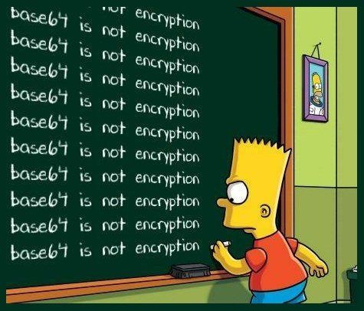
Did I make my point?

Slide 8
Encryption vs. Obfuscation
Malware authors use algorithms to disguise their malware
Attempts to evade Intrusion Detection and Anti-Virus
Makes it more difficult for defenders to reverse engineer the malware
Advertising often uses obfuscation and thus looks like malware
Malware normally attacks any computer it comes across
Therefore, it does not normally use a key. If it does use a key, the key is usually publicly accessible
Techniques/algorithms are as varied as the malware authors are imaginative.
Nonetheless, if all computers can decode the malware, reverse engineers can usually decode it as well
Notes:
https://www.sans.org/reading-room/whitepapers/engineering/pdf-obfuscation-primer-34005
https://www.sans.org/reading-room/whitepapers/malicious/obfuscation-polymorphism-interpreted-code-37602
In rare cases (state sponsored malware is one) the malware can be so specifically targeted that the configuration of the target computer effectively becomes a key.
See Zero Day by Kim Zetter, about Flame and Duqu. If the attacker has a lot of specific information about the target (OS type, software installed, hardware configuration and serial numbers, MAC address, etc.) the software can be written so that it runs only on that computer. Malware researchers will have to duplicate the configuration to be able to examine the malware.
On the other hand, malware that is designed to run on many or all computers will have to have simpler obfuscation and is susceptible to reverse engineering.

Slide 9
Cryptography—major areas
Symmetric Encryption
Same key used for encryption and decryption
Asymmetric Encryption
One key encrypts, another key decrypts
Protocols
Exchanging keys and traffic in a secure manner
Notes:
A fundamental difference in types of encryption algorithms is that between symmetric and asymmetric encryption.
Symmetric encryption has been around for thousands of years. The Caesar cipher is an example. The basic property of symmetric encryption or a symmetric cipher is that the same key is used for both encryption and decryption.
Asymmetric encryption is new, with the first publications occurring around 1976. It relies on mathematical functions and uses a pair of two keys. If a message is encrypted with one of the keys, it can only be decrypted with the other key in the pair.
The other major area of work in cryptography is the development of protocols so that keys and encrypted data can be exchanged in a secure manner.

Slide 10
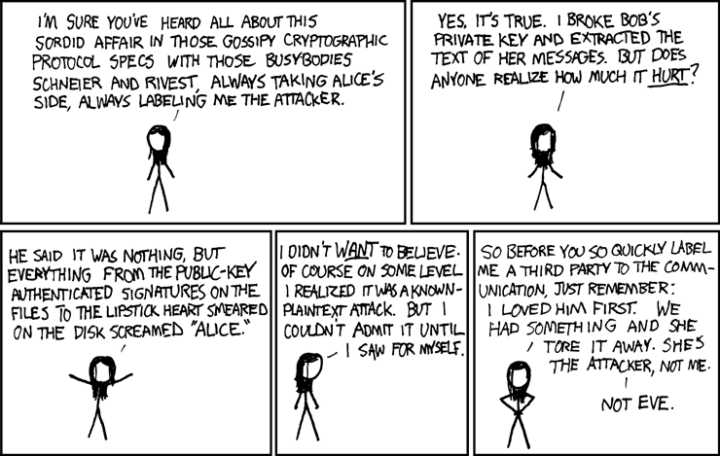
Diversion: Alice, Bob, Eve, Mallory, et al.
Common Crypto example
Alice and Bob attempt secure communication
Eve is an Eavesdropper
Mallory does MITM attacks
Others as needed
https://xkcd.com/177/
https://en.wikipedia.org/wiki/Alice_and_Bob
Notes:
Cryptography examples almost always include Alice and Bob as the two people trying to exchange data securely. Often the attacker is Eve (for eavesdropper) but there are many other names for attackers in use, depending on their method of attack.

Slide 11
Symmetric Encryption
Same key used both for encryption and decryption
Advantage
FAST
Disadvantage
Both sides (Alice and Bob) must have the same key
How do they agree on a key without Eve getting the key as well?
Agreeing on a key, securely
Out of channel—Alice gives the key to Bob in person, or something similar
Key exchange protocols
Use other forms of encryption to transmit the key
Notes:
There are two key things to remember about symmetric encryption, speed and key exchange.
Symmetric encryption can be implemented directly in hardware, or in low level code like assembly language. It consists of simple operations that can be done quickly. Therefore, it is very fast.
However, the key must be given to the other party so the message can be decrypted. If the attacker can intercept the key, the attacker can also decrypt the message, no matter how good the encryption is. This is called the key exchange problem.

Slide 12
Asymmetric Encryption
Also known as public key encryption
One key used for encryption, one key for decryption
Advantage
Done properly, it allows for secure key exchange
Disadvantage
Slow, ~1,000 times slower than symmetric encryption
Each encryption/decryption cycle requires taking a large (1024 bits or more) number to a large exponent
Usually, use Asymmetric encryption for key exchange then switch to symmetric to encrypt data
Notes:
Asymmetric encryption involves complex mathematical operations, generally taking very large numbers to very large exponents. These operations are slow, so asymmetric (or public key) encryption is slow.
Asymmetric encryption has the advantage that it can transfer data securely without having to pass the key to the other party. Assume Alice creates a public/private key pair and posts the public key in a trusted location that Bob can access. If Bob encrypts data with Alice’s public key, it can only be decrypted with Alice’s private key. If Alice has kept her private key secret, then the message can be transmitted securely.

Slide 13
Enigma and the beginning of the computer age
Enigma—mechanical encryption used by Germany in WW II
Developed after WW I
Used removeable rotors that moved at variable rates
Key was which rotors were selected, their order, starting position, and which cables were installed in a plugboard.
Cracking Enigma led to the development of computers
Bombe—mechanical computer built to crack Enigma messages
First developed in Poland
Refined at Bletchley Park, UK, by Alan Turing
Almost all encryption in use since then is computer-based
Current laptop can easily crack Enigma messages

